Slide 1

NLP RESEARCH PROJECT
Meta Shift: Tracking Game Balance Changes with NLP
Bootstrapping Transformers via Distant Supervision
Authors: Matei-Ștefan Ungureanu & George Manolachi

Slide 2

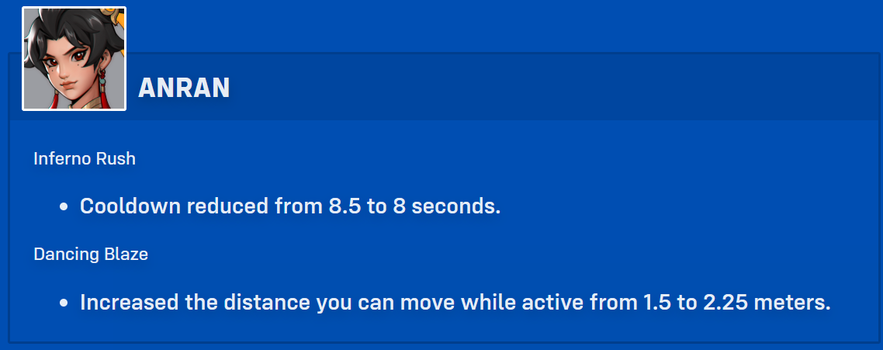
MOTIVATION
The Problem
In competitive multiplayer games, keeping track of balance changes introduced through updates can be time-consuming, since patch notes are usually written in unstructured natural language.
Manual Overhead
Domain Vocabulary Gap
Manual tracking is overwhelming, slow, and fails to reveal long-term "meta" shifts and which strategies remain effective.
Video game jargon (e.g., "Hitscan", "Cooldown") makes standard software engineering extraction tools ineffective for this domain. Example of a standard zero-shot model classification:
Text: Tracer's Pulse Pistols Damage reduced from 6 to 5.5
[PRODUCT] Tracer, [CARDINAL] 6, [CARDINAL] 5.5
Text: Zenyatta's Transcendent Condemnation Removed.
[ORG] Zenyatta, [ORG] Transcendent Condemnation Removed

Slide 3

SYSTEM OVERVIEW
Introducing Meta Shift
Meta Shift is an automated rule-based NER pipeline designed to extract, decipher, and summarize balance changes from game patch notes.
1
2
Data Extraction and Standardization
Phrase matching for domain entities
The system asynchronously extracts data from community Fandom Wiki APIs for up-to-date patch coverage and standardizes it
Scans the text for known game terms from curated lists (heroes, abilities, stats, status effects, etc.) and marks them as entities.
3
4
Entity Extraction
Total Balance Change
Identifies entities such as the HERO and ABILITY the unstructured text refers to, as well as the type of change that occurs
Calculates the overall changes in the meta and outputs them in a structured format

Slide 4
PHASE 1
Rule-Based NER Baseline
The first step uses a spaCy rule-based system relying on curated domain-specific dictionaries and dependency parsing heuristics.
Domain Dictionaries
Curated vocabulary of game-specific terms forms the lexical backbone of entity recognition.
Normalizing Raw Text
Cleans/standardizes the text so matching works consistently.
Dictionary match
Finds known heroes / abilities / stats by exact phrase matching from the dictionary.
Matching subjects and change type
Decides the type of change (numerical/mechanical) and saves it linked to the respective hero and ability.
Output
Computes net value for numerical changes and outputs the mechanical changes in a structured format.
The Bottleneck
Rule-based systems are brittle and struggle with new or unusual phrasing. While they can be precise on standard patch notes, they need constant manual updates as developers’ language evolves.

Slide 5

PHASE 2
Transformer Bootstrapping
To ensure long-term robustness, the system uses the rule-based output as an automated distant-supervision annotator to fine-tune a deep learning model.
Distant Supervision
RoBERTa Fine-Tuning
Multi-Head Self-Attention
Rule-based output automatically labels a large dataset, circumventing the prohibitive costs of manual annotation entirely.
A RoBERTa-base transformer is fine-tuned on the automatically annotated corpus for robust sequence labeling.
Unlike linear models with limited windows, the transformer learns deep contextual embeddings via multi-head self-attention.
Syntactic Generalization
The model generalizes seamlessly to unforeseen syntactic structures that defeat brittle rule-based heuristics.
Rule‑Based spaCy NER
Auto-Labeled Data
RoBERTa Fine‑Tuning

Slide 6

RESULTS
Evaluation & Results
The models were validated against a chronological Train/Dev/Test split, utilizing a holdout set of 2026 patch notes to test robust generalization.
Rule-Based Baseline:
Used heavily-engineered heuristics to automatically annotate 2,375 training examples from 2016–2025.
Fine-Tuned RoBERTa:
Evaluated on 156 unseen modern patch lines, achieving an 89.23% Overall F1-Score.
HERO: 93.84% F1
ABILITY: 90.23% F1
STAT: 77.55% F1
Takeaway:
Deterministic rule-sets can successfully bootstrap robust deep learning language models for metadata extraction in gaming.

Slide 7



CRITICAL ANALYSIS
Limitations
Understanding the constraints of the current pipeline is essential for guiding future improvements and managing expectations.
Propagated Bias
Boundary Friction (STAT drop)
Format Dependency
Because training data is automatically annotated, any recurring false positives or biases in the rule-based heuristics inevitably propagate to the transformer model.
This bias directly caused the lower STAT performance (77.55% F1). The rule-based parser aggressively infers long, complex stat strings, whereas the Transformer learned stricter, tighter token boundaries, causing partial evaluation mismatches.
The pipeline relies heavily on the structural formatting of current Fandom wikis. A radical shift in how patches are documented upstream would require refactoring the initial web scrapers.

Slide 8




ROADMAP
Future Work
Three promising directions for extending Meta Shift into a more powerful and verifiable game analytics system.
LLM Integration
Transition from token-level NER to high-parameter Large Language Models (LLMs) like LLaMA 3 or GPT-4 for richer extraction capabilities.
Instruction Tuning
Generate natural language summaries about macro-level game trend consequences rather than just span extraction from raw patch text.
Empirical Verification
Correlate extracted patch data with historical player win-rate datasets to map patch text to actual measurable shifts in the game's meta.

